Slide 1
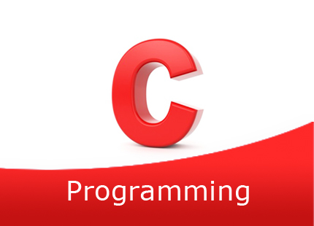

Slide 2
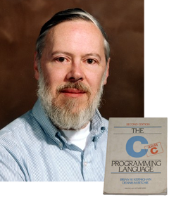
INTRODUCTION TO C
Initially a general purpose lanaguage called ALGOL.
Later CPL, then BCPL, then B finally C.
C is a programming languague developed at AT &T’s Bell Laboratories of USA in 1972
It is designed & developed by Dennis MacAlistair Ritchie
It become popular within 70’s and sustained 3 decades
C is reliable, simple,easy to learn.

Slide 3
Characters Used in C Programs
Lowercase letters
a b c . . . z
Uppercase letters
A B C . . . Z
Digits
0 1 2 3 4 5 6 7 8 9
Other characters
+ - * / = ( ) { } [ ] < > ‘ “
! @ # $ % & _ ^ ~ \ . , ; : ?
White space characters
blank, newline, tab, etc.

Slide 4
The Six Kinds of Tokens in ANSI C
Keywords
Identifiers
Constants
String Constants
Operators
Punctuators

Slide 5
Keywords
Keywords are C tokens that have a strict meaning.
They are explicitly reserved and cannot be redefined.
ANSII C has 32 key words.
Some implementations such as Borland’s C or Microsoft’s C have additional key words.

Slide 6
ANSII C Keywords
auto do goto signed unsigned
break double if sizeof void
case else int static volatile
char enum long struct while
const extern register switch
continue float return typedef
default for short union

Slide 7
Identifiers
An identifier is a token:
Composed of a sequence of letters, digits, and the underscore character _
Note: Variable names are identifiers
Lower- and uppercase letters are treated as distinct.
Identifiers should be chosen so that they contribute to the readability and documentation of the program.

Slide 8
Special Identifiers
main
C programs always begin execution at the function main.
Identifiers that begin with an underscore should be used only by systems programmers
Because they can conflict with system names.

Slide 9
Constants
Integer Constants
25 and 0
Floating Constants
3.14159 and 0.1
Character Constants
‘a’ and ‘B’ and ‘+’ and ‘;’ but not “a” or “B”

Slide 10
Special Character Constants
The backslash is called the escape character.
The newline character ‘\n’ represents a single character called newline.
Think of \n as “escaping” the usual meaning of n.
Enumeration constants will be discussed later in the course.

Slide 11
String Constants
A sequence of characters enclosed in a pair of double quote marks, such as “abc” is a string constant, or a string literal.
Character sequences that would have meaning if outside a string constant are just a sequence of characters when surrounded by double quotes.
String constants are treated by the compiler as tokens and the compiler provides the space in memory to store them.

Slide 12
Is it a String or Not a String?
“this is a string constant”
“” /* the null string */
“ “ /* a string of blanks */
“ a = b + c; “ /* is not executed */
“ /* this is not a comment */ “
/* “ this is not a string “ */
“ and
neither is this “
‘a’ /* a character, not a string */

Slide 13
The Mathematical Operators
We looked at the mathematical operators briefly in the 3rd class:
+ - * / %
In a C program we typically put white space around binary operators to improve readability.
a + b rather than a+b

Slide 14
The sizeof Operator
The C sizeof unary operator if used to find the number of bytes needed to store an object.
sizeof(object) returns an integer that represents the number of bytes needed to store the object in memory.

Slide 15
printf()
printf(control string, other arguments);
The expressions in other_arguments are evaluated and converted according to the formats in the control string and are then placed in the output stream.
printf(“%-14sPayRate: $%-4.2f\n”, “James Smith”, 8.95);
James Smith Pay Rate: $8.95
Characters in the control string that are not part of a format are placed directly in the output stream.

Slide 16
The Formats in the Control String
printf(“Get set: %d %s %f %c%c\n”,
1, “two”, 3.33, ‘G’, ‘O’);
%d Print 1 as a decimal number
%s Print “two” as a string
“string” means a sequence of characters.
%f Print 3.33 as a float
decimal or floating-point number
%c Print ‘G’ & ‘0’ as characters.

Slide 17
printf ( ) Example
printf(“Get set: %d %s %f %c%c\n”,
1, “two”, 3.33, ‘G’, ‘O’);
The first argument is the control string
“Get set: %d %s %f %c%c\n”
The formats in the control string are matched (in order of occurrence) with the other arguments.

Slide 18
Use of scanf()
scanf() is analogous to printf(), but is used for input rather than output.
scanf()in a program stops the execution of the program while you type something in from the keyboard.

Slide 19
scanf ( ) Arguments
The first argument is a control string with formats similar to those used with printf().
The formats determine how characters in the input stream (what you are typing) will be interpreted so they can be properly stored in memory.

Slide 20
Scanf ( )’s Other Arguments
After the control string, the other arguments are addresses.
Example: assume x is declared as an integer variable.
scanf(“%d”, &x);
The & is the address operator. It says “store the value entered at the address of the memory location named x”.

Slide 21
scanf ( ) Conversion
Conversion How characters in the
Character input stream are converted.
c
d
f
lf
Lf
s
Character
decimal integer
floating-pint number (float)
floating-point number (double)
floating-point number (long double)
string

